Slide 1
Building Access in IdentityNow

Slide 2



Identity Model Components
Identity
A representation of a person or service and all the information associated with them.
This includes security-relevant information as well as current status in the organization.
Account
A representation of an identity on a source system. This user account contains information about the identity and may also contain accesses as well.
Access
These are securities which grant accounts an ability to perform actions. They define what a user can and can’t do in a system.
On a source these may be known as entitlements, authorizations, groups, rights, permissions, etc.
Access can also be defined through roles and access profiles too.

Slide 3



Identity
Account
Access

Slide 4
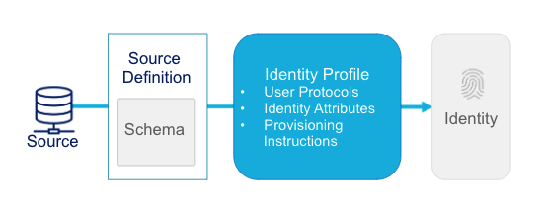
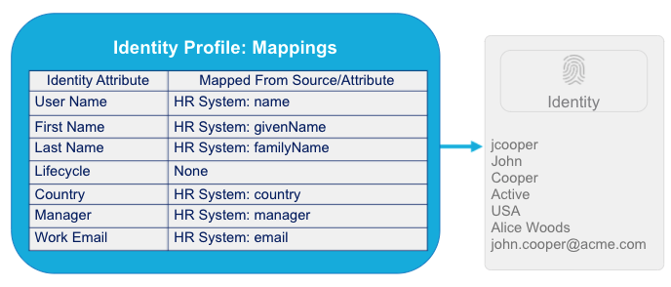
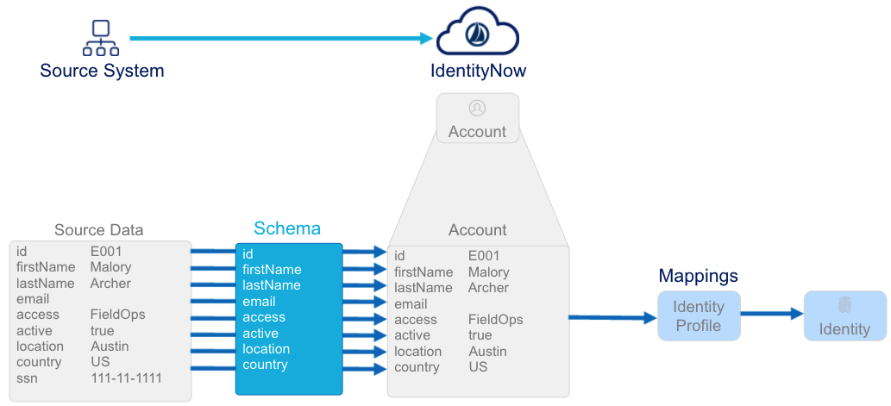
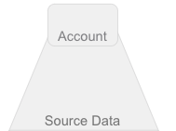
Reading from
Leading HR Source
Notes:
Authoritative Source = Systems of Record

Slide 5
Building Identities
Create Authoritative Source
  Admin > Connections > Sources > +New
Create Identity Profile
  Admin > Identities > Identity Profiles > +New
Configure Identity Profile
  Associate Identity Profile with Source
  Define identity mappings
Aggregate Authoritative Source Accounts
  Admin > Connections > Sources > Import Data (tab) > Import Accounts

Slide 6
Identity Profiles
An identity profile is a template for creating identities, and a place where identity policy is defined.
  Commonly Aligned to Identity ‘type’ - i.e. Employees, Contractors, Students, Faculty, etc.
Configured by in the admin interface:
  Admin > Identities > Identity Profiles.
An identity can only be assigned by a single identity profile.
  Implicit priority / ordering in the user interface.
  Priority can also be adjusted by REST API.

Slide 7
Identity Profile Settings
Settings define policy about the identity profile.
The Account Source section defines the authoritative source.
The Sign-in Method defines the authentication source for the user.
  e.g. IdentityNow, Active Directory
There are additional options for how and where a user can sign-in.
  Off Network
  Untrusted Geographies
  Strong authentication

Slide 8
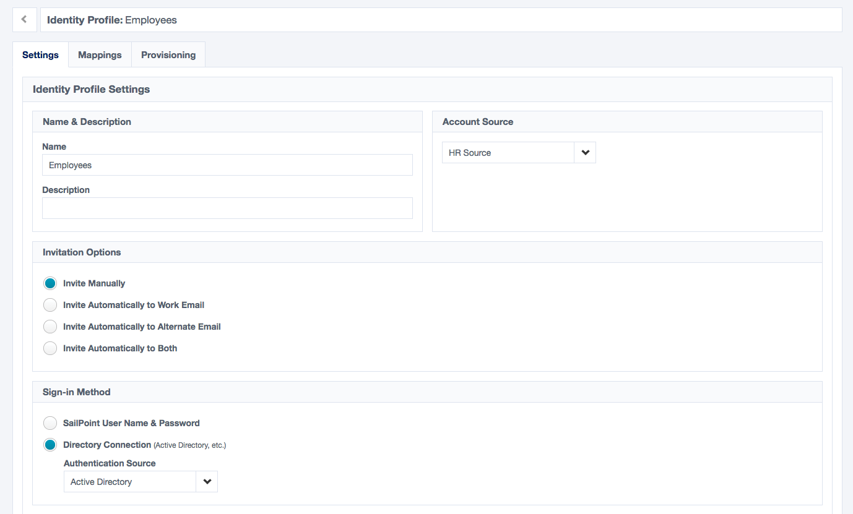
Identity Profile Settings

Slide 9
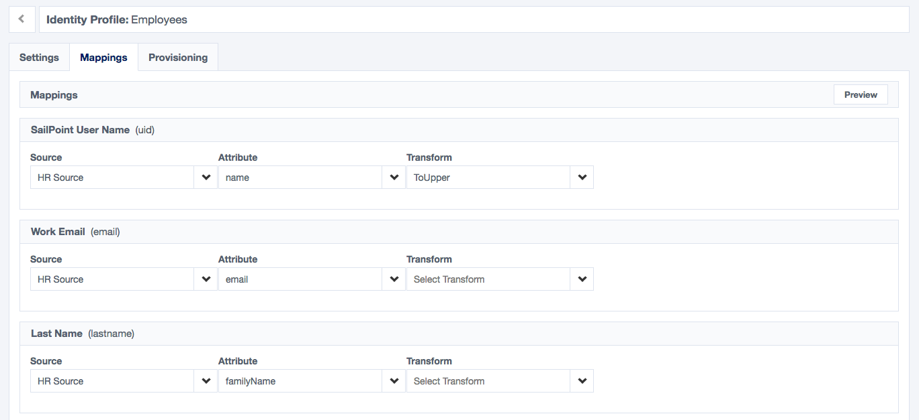
Identity Profile Mappings

Slide 10
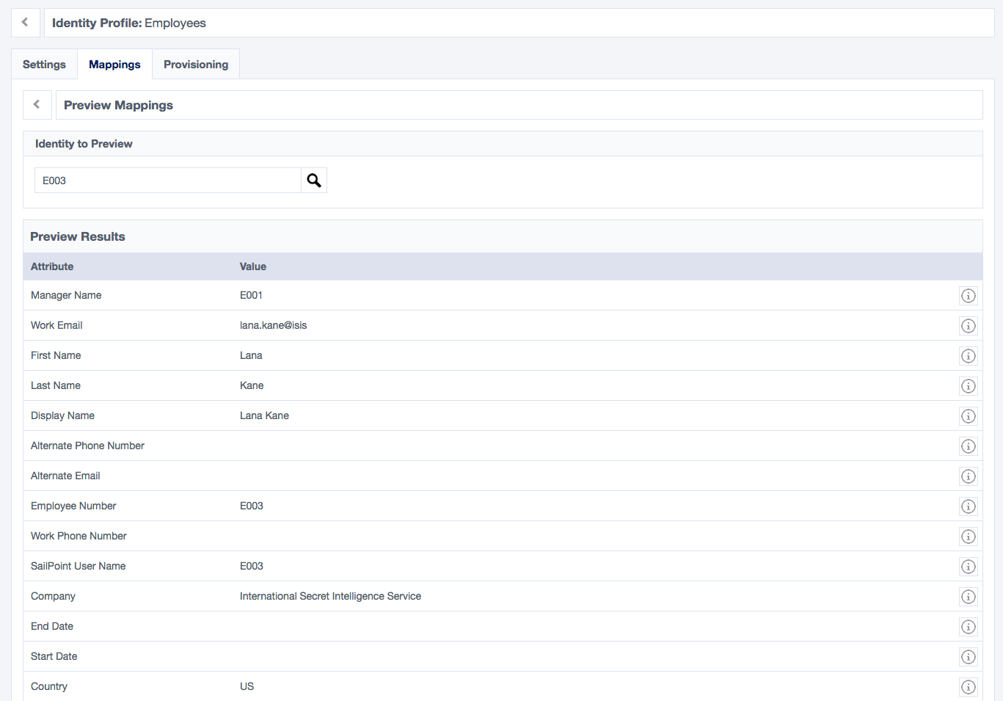
Identity Preview
Requires Aggregated Account Data
Excellent
for transform testing

Slide 11
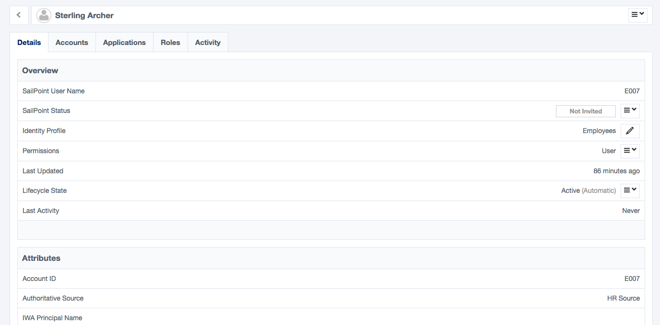
Administrative View of an Identity
Access Details
Account Details
Identity Details

Slide 12
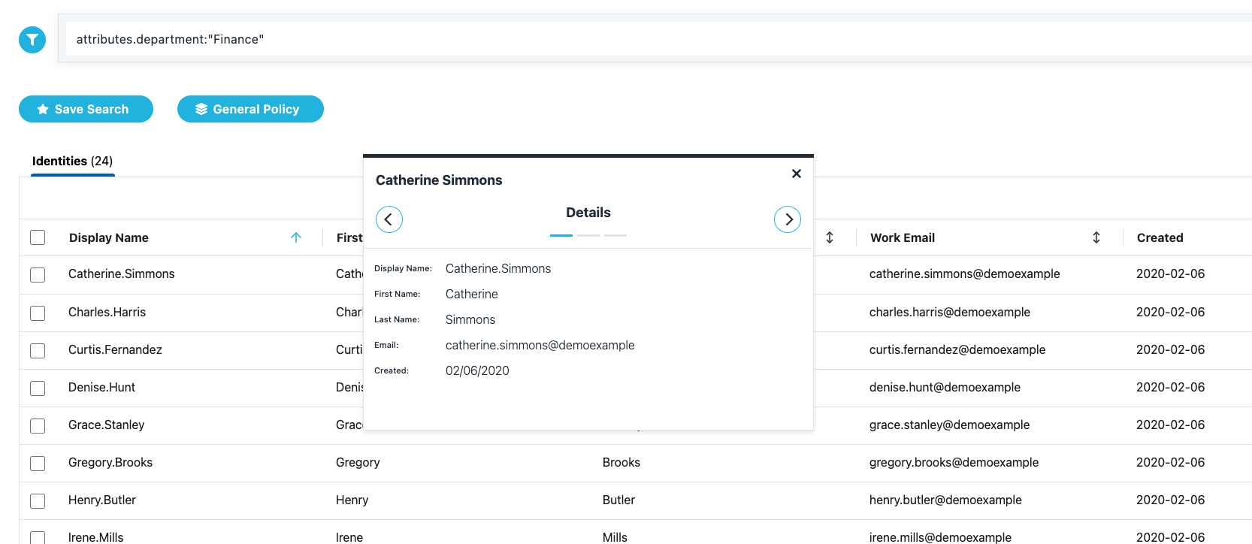
Search View of an Identity
Query
Identity Details
Search Results

Slide 13
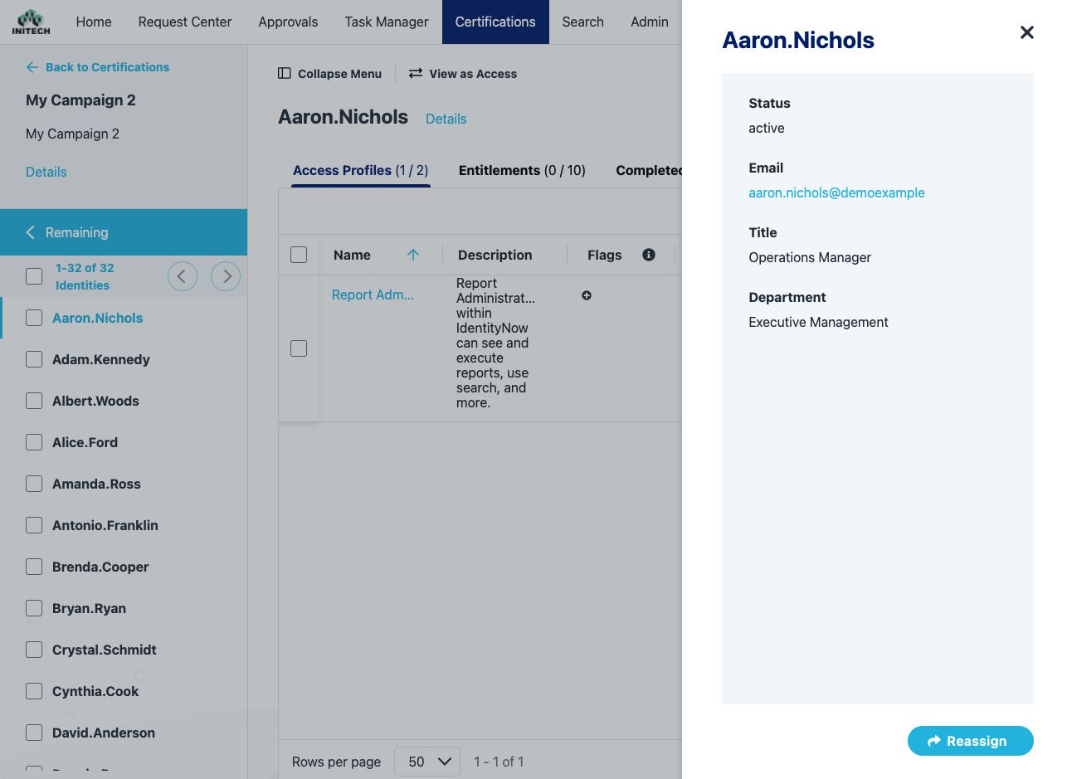
Public View of an Identity
Identity Details
Public Identity Attributes

Slide 14
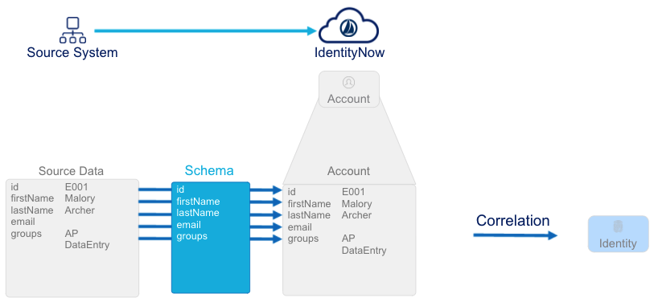
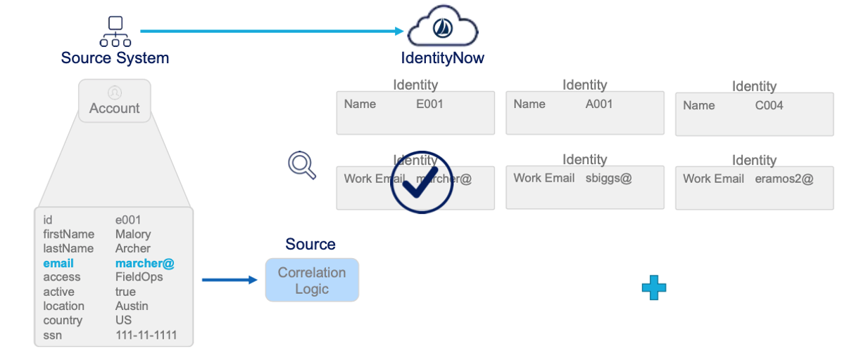
Read Accounts (other)
Correlation to Identities

Slide 15
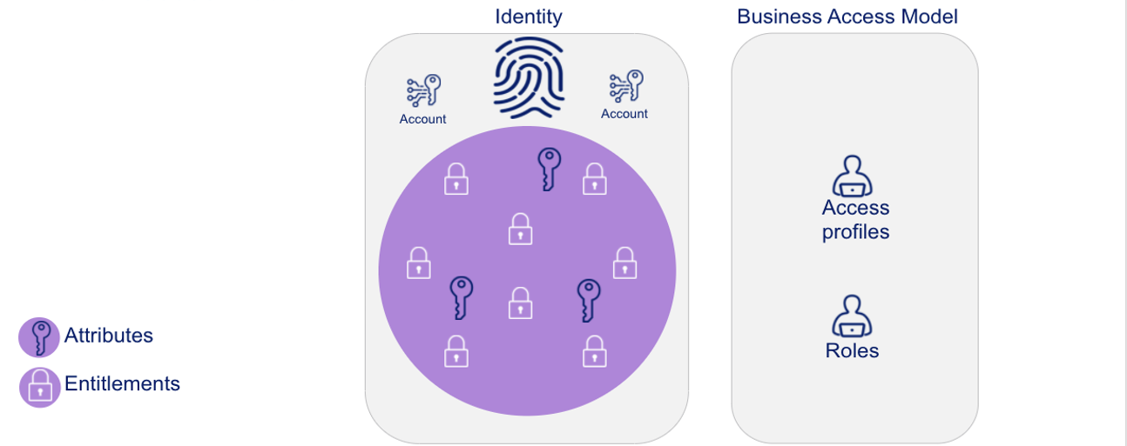
Access Model Components

Slide 16
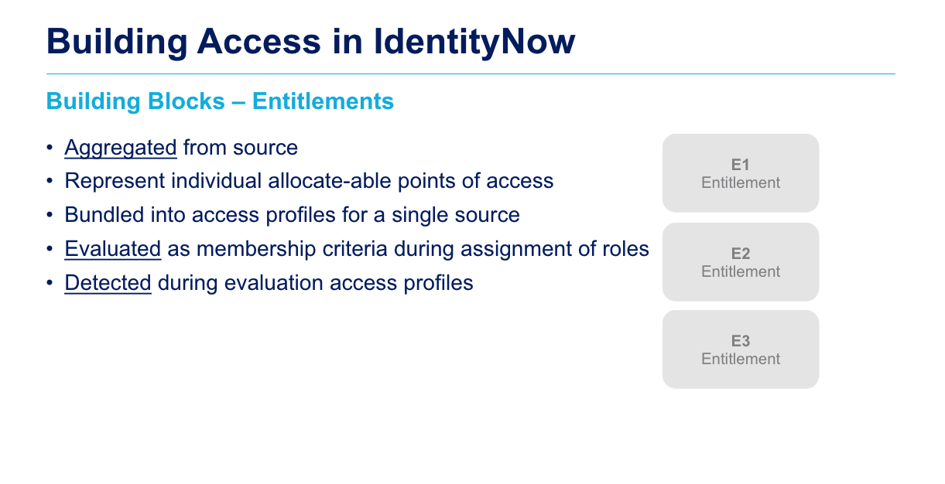
Access rights, including group memberships or access permissions, that have been granted to a user who has an account on the related source.
Notes:
Access rights including group memberships and access permissions

Slide 17
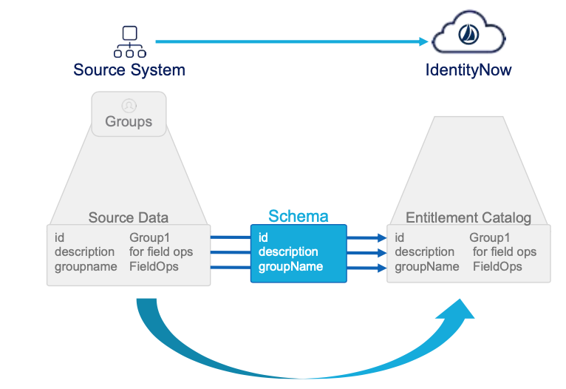
Read Entitlements from Sources
Notes:
Entitlements: Access rights, including group memberships or access permissions, that have been granted to a user who has an account on the related source.

Slide 18
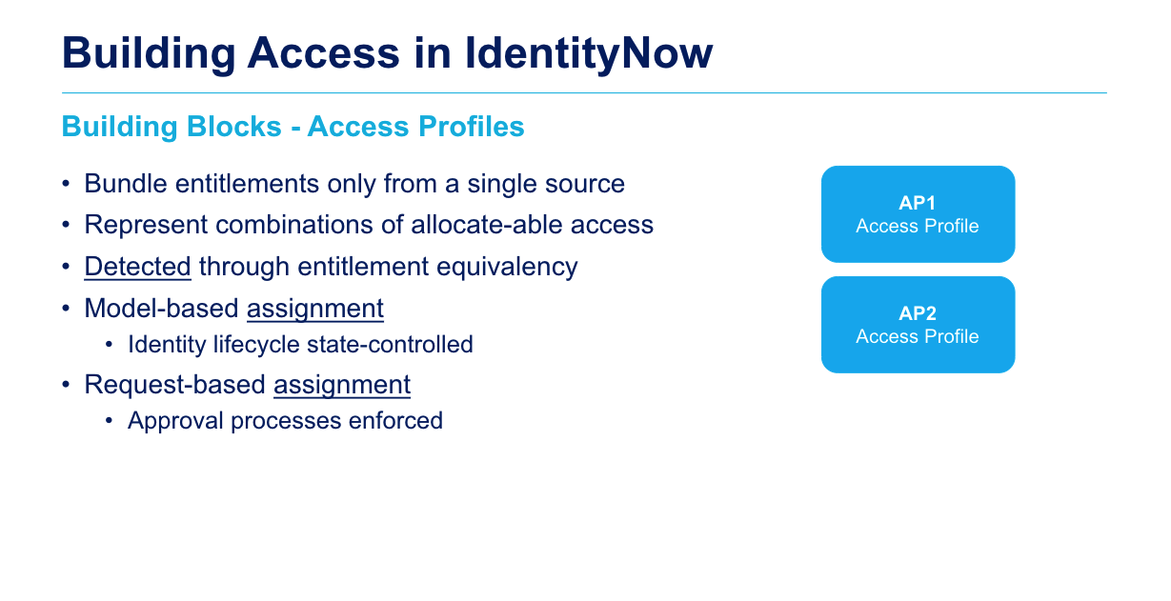
Notes:
Access Profiles: one or more entitlements from a single source system (application) bundled and should be assigned as one unit.
User’s can also request Access Profiles directly through the IDN Request Center.
Optional approval process (for AP) (if configured) when requesting access
Detection: IDN compares (after aggregation of accounts and entitlements) the entitlements held by the user with the entitlements bundled on the access profile.
If the identity has all the entitlements contained within the access profile, the access profile is detected (and enabled) for that identity.

Slide 19
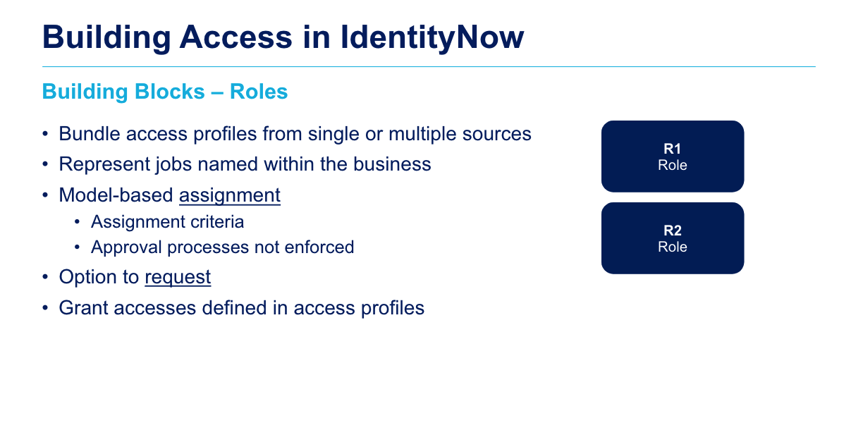
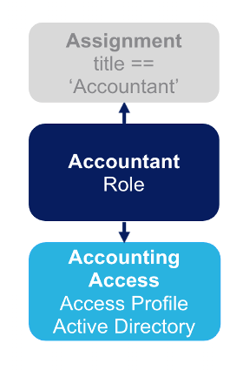

Slide 20
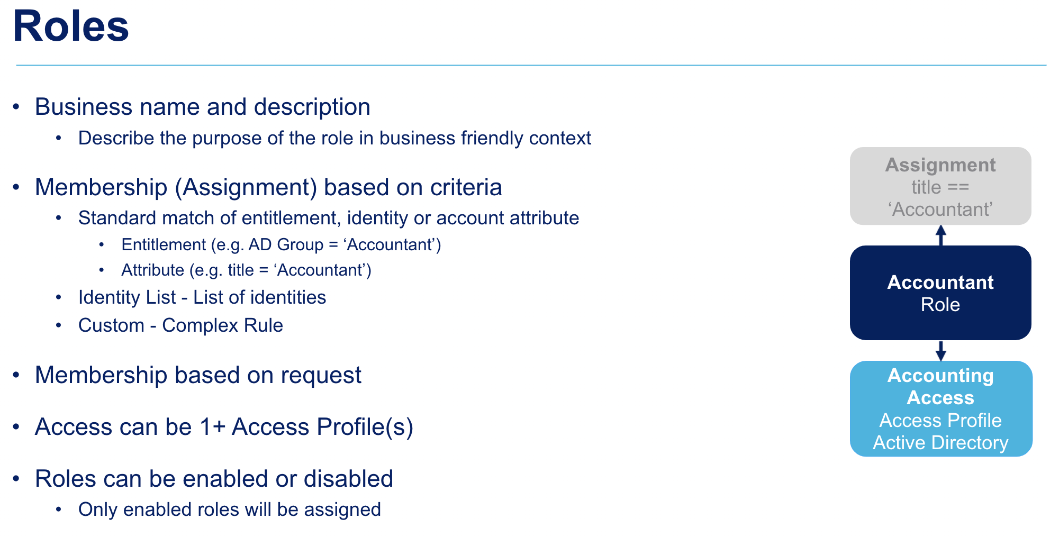
Notes:
you may use entitlements as a membership criteria to assign roles.
Identities are assigned to a role, if they meet the roles membership matching criteria.
Once a role is assigned, IDN will provision the appropriate entitlement that are contained within the roles access profile.
NO approval process is initiated.
Roles can be requested as well
Roles grant the included access profile to provide access to members

Slide 21
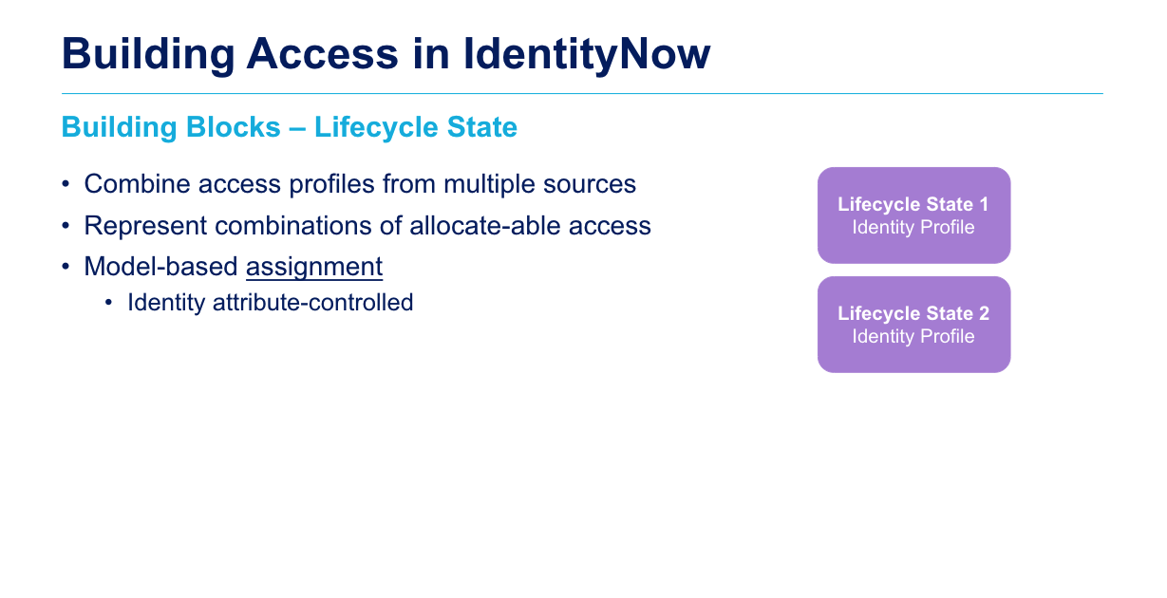

Slide 22
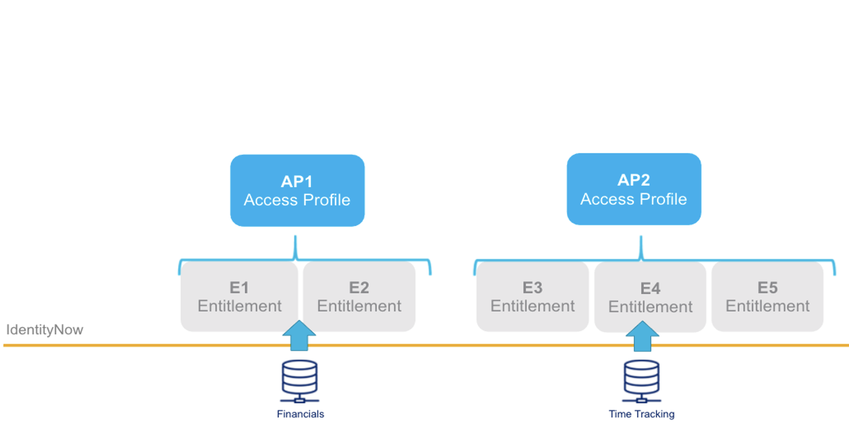
Role Concept & Management
Application: Container to combine multiple Access Profiles, helps to structure
Application A1
Role R1
Role R2
Role R3
Business Role: A user has one or more business roles, depend on OrgUnit, Job Role, Department, User Types
Technical Role: one or more
Entitlements of the same source
AP3
Access Profile
Entitlements: Access rights, including group memberships or access permissions, that have been granted to a user who has an account on the related source.
Active Directory

Slide 23
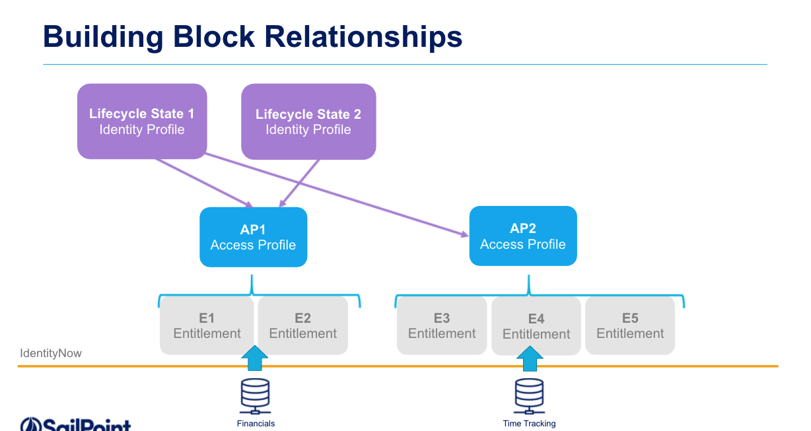

Slide 24
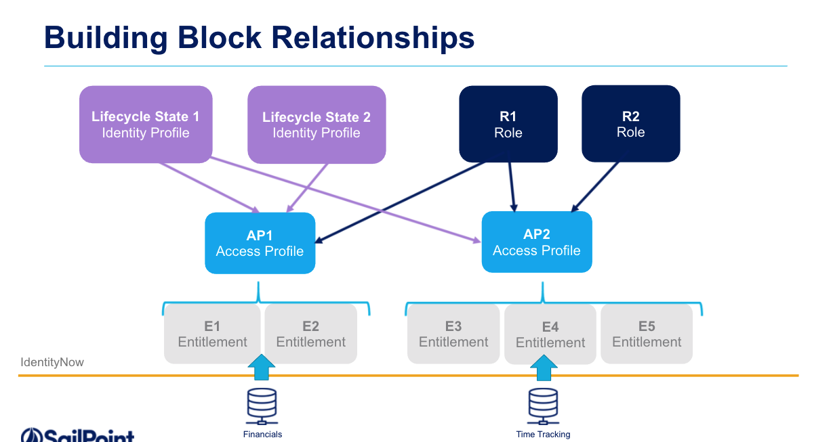

Slide 25
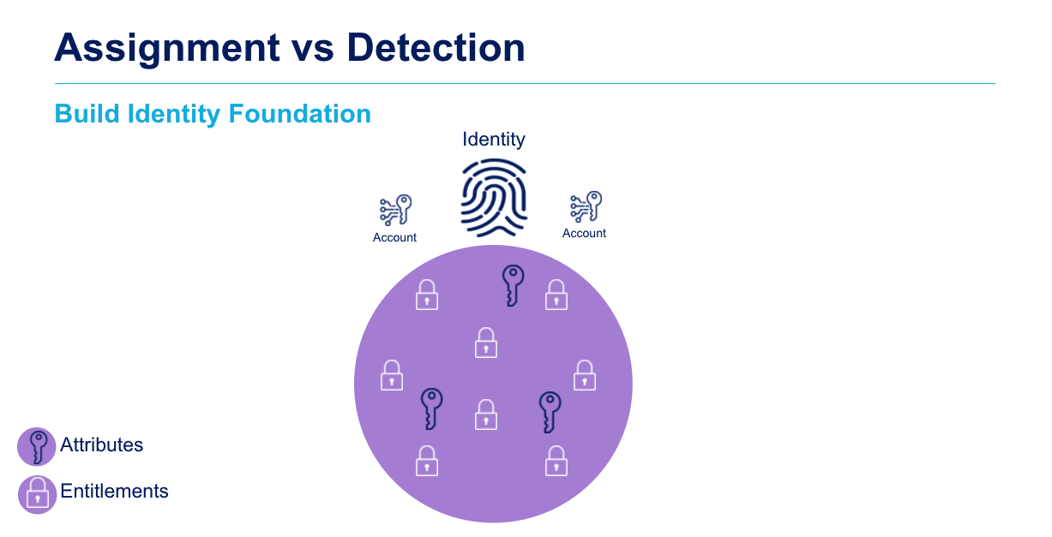
Notes:
Source creation, aggregate/load accounts and entitlements

Slide 26
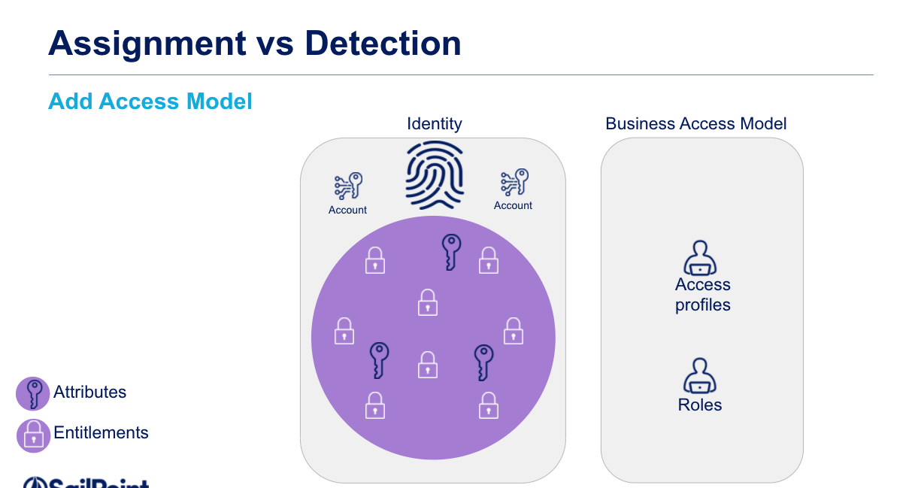

Slide 27
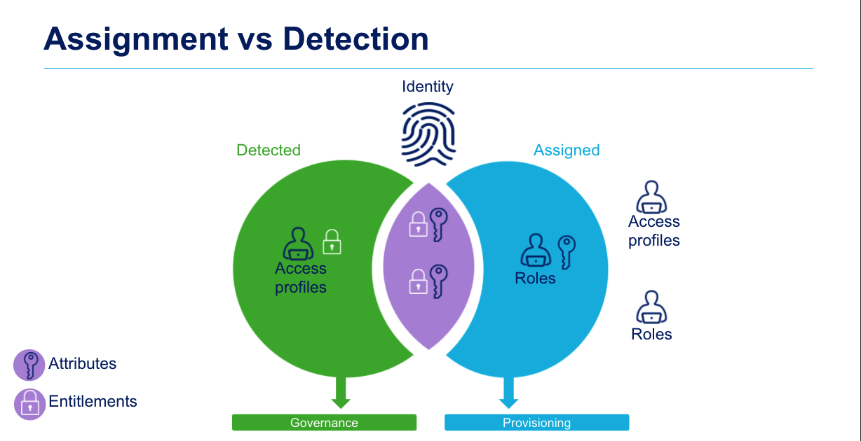
Notes:
Detection: IDN compares (after aggregation of accounts and entitlements) the entitlements held by the user with the entitlements bundled on the access profile.
If the identity has all the entitlements contained within the access profile, the access profile is detected (and enabled) for that identity.

Slide 28
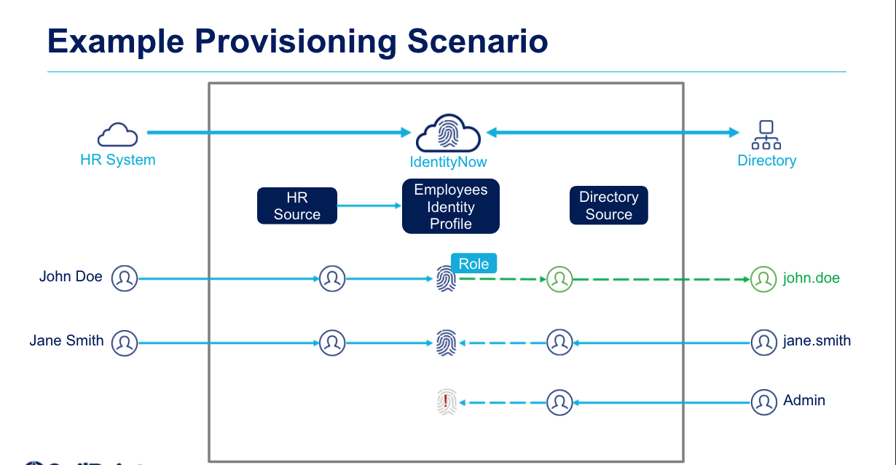

Slide 29
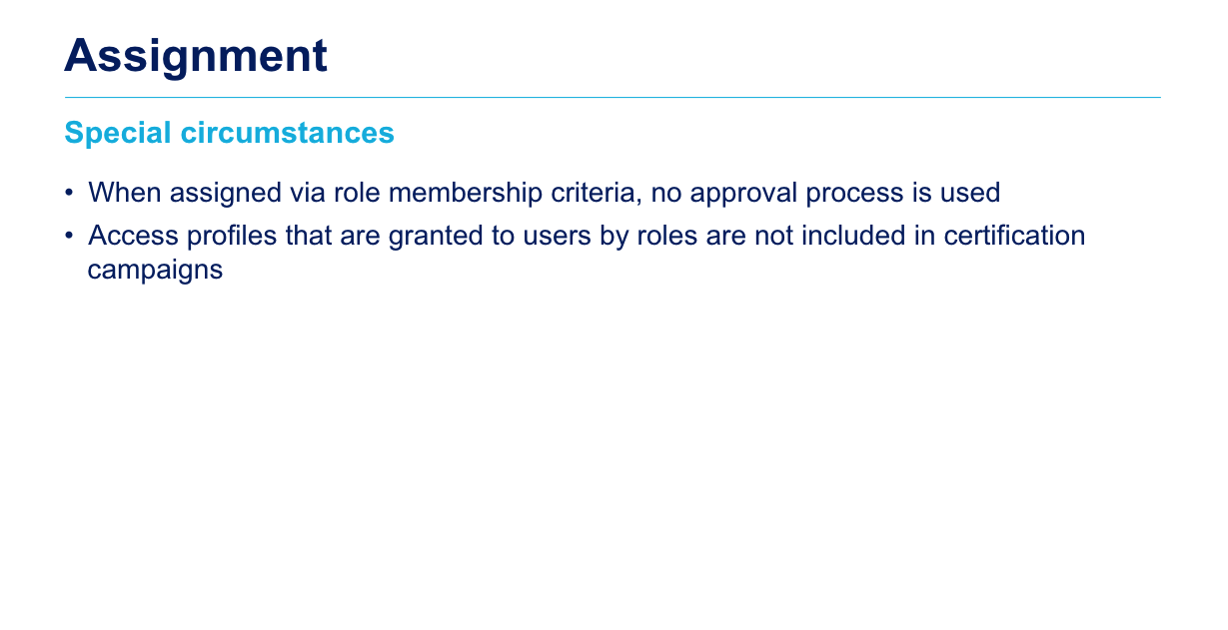

Slide 30
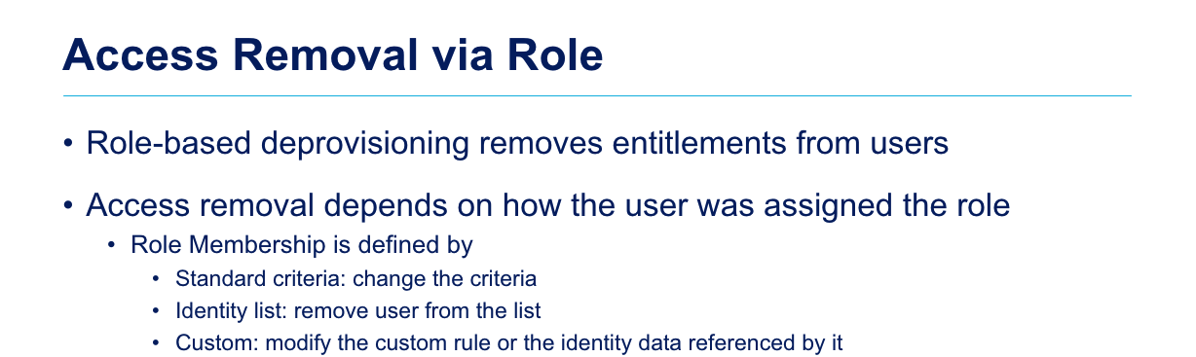
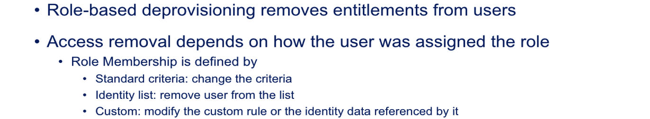
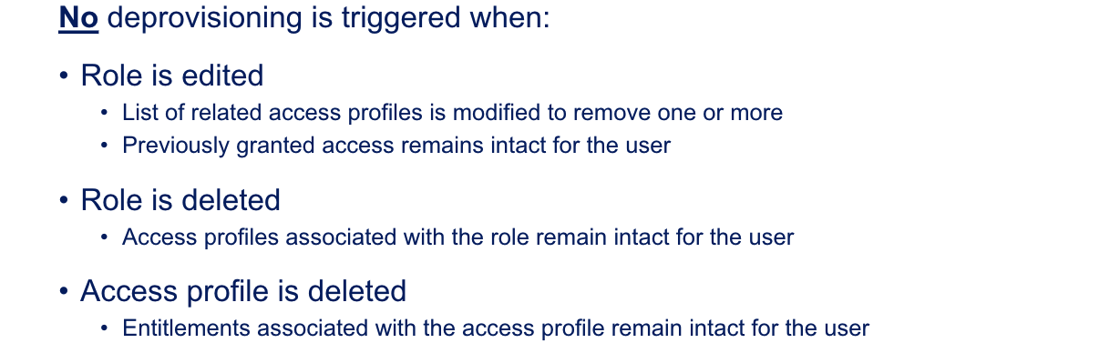

Slide 31
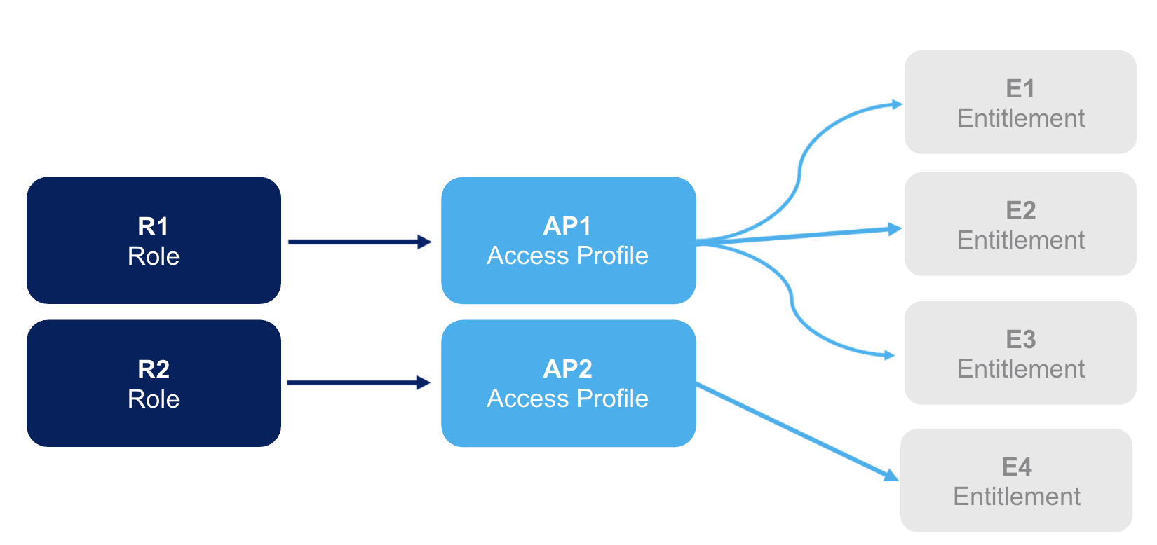
Access Profiles and Roles

Slide 32
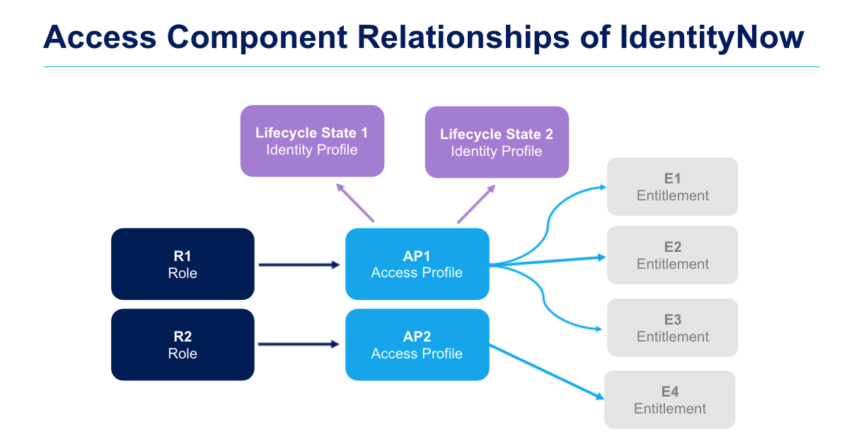
Notes:
Lifecycle states (defined in identity profiles) may grant 1-n Access Profiles (when an identity has moved into a new state) to provide/remove access to (role) members.
Identity profiles: templates that describe how to create and model identities from a single, specific incoming source, must be an authoritative source !

Slide 33
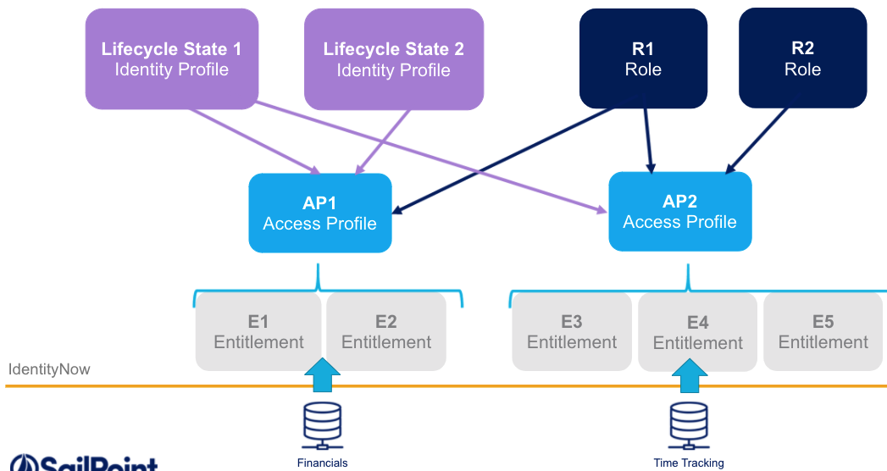
Access Profiles, Roles, Sources & Lifecycle States

Slide 34
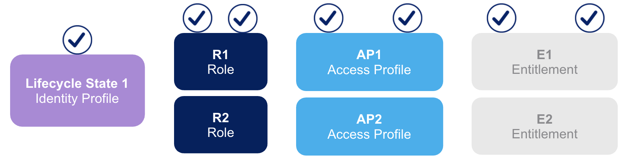
Each ONE Identity can

Slide 35








Authorizations model
0..N
Role
Identity
0..N
Access Profile
Application
0..N
0..N
1..N
1..N
1..1
Account
0..N
Entitlement
1..1
Source

Slide 36
Building Blocks
Identity Profile
Role
Identity
0..N
Access Profile
0..N
Application
0..N
0..N
Accounts
1..N
1..N
1..1
Account
0..N
Entitlement
1..1
Source
Auth. Source
Notes:
Authoritative Source = Systems of Record
Other Sources = 3rd party Appl, databases, directory management system

Slide 37
Building Blocks
Identity Profile
Identity
Account Profile
0..N
1..N
1..N
1..1
Account
0..N
Entitlement
1..1
Source
Auth. Source
Notes:
Authoritative Source = Systems of Record
Other Sources = 3rd party Appl, databases, directory management system

